Slide 1

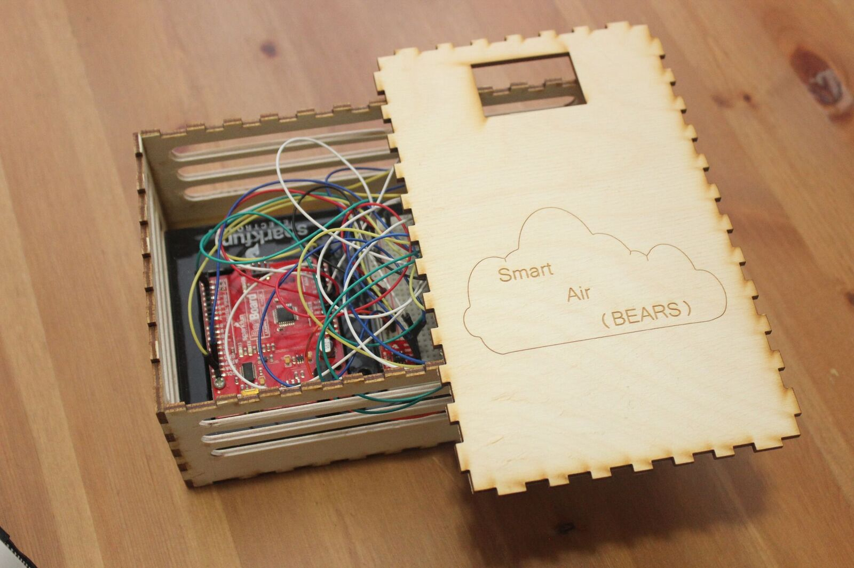



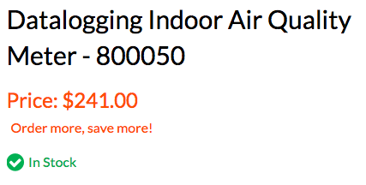
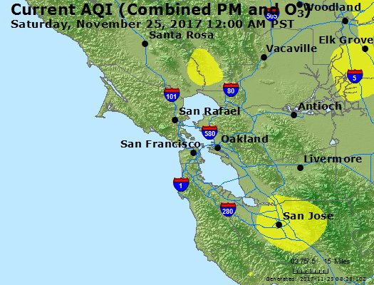
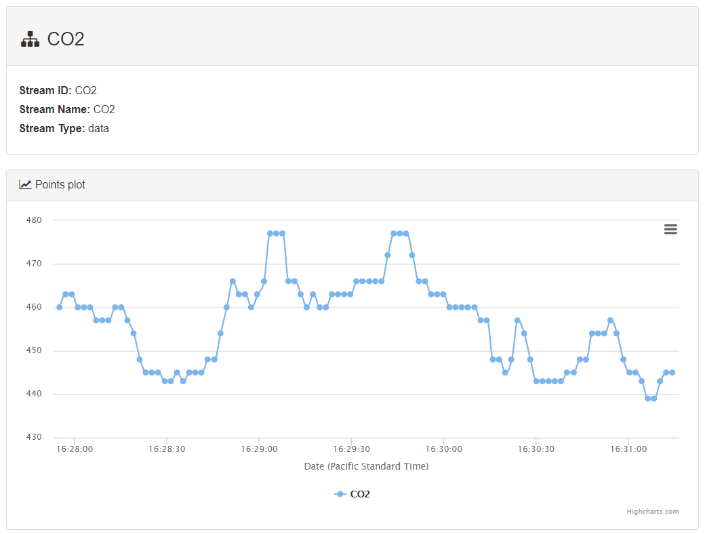
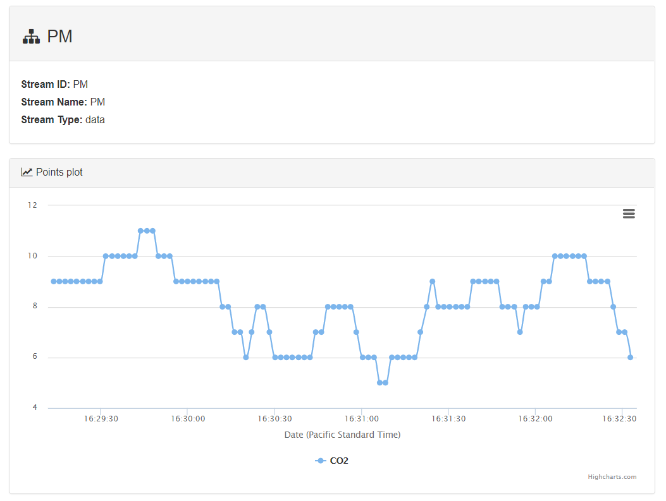
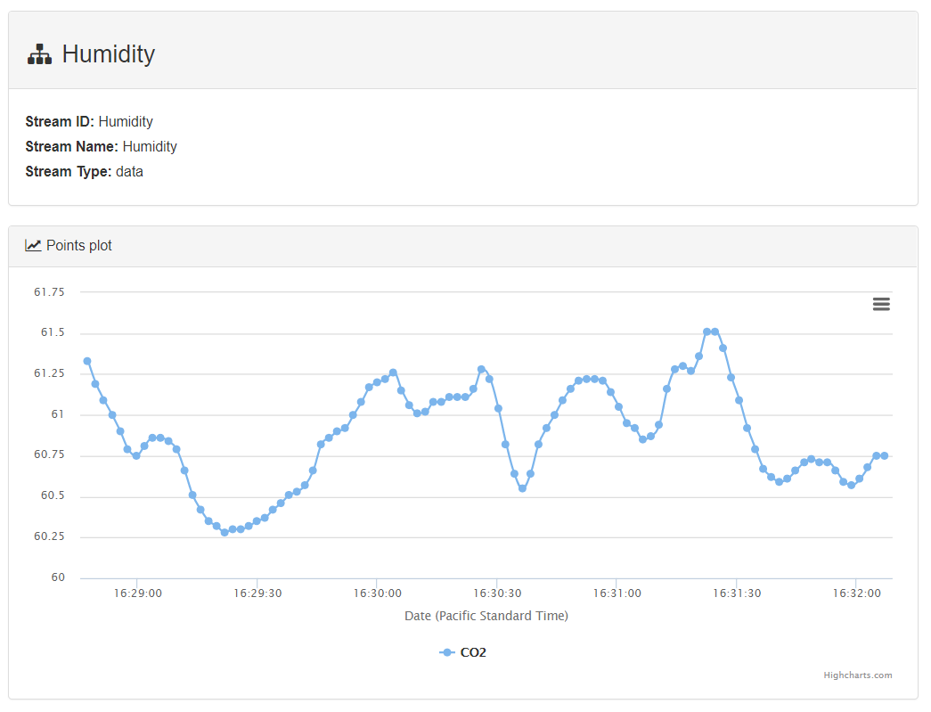
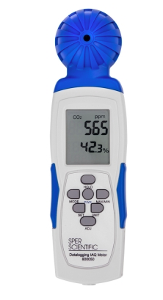




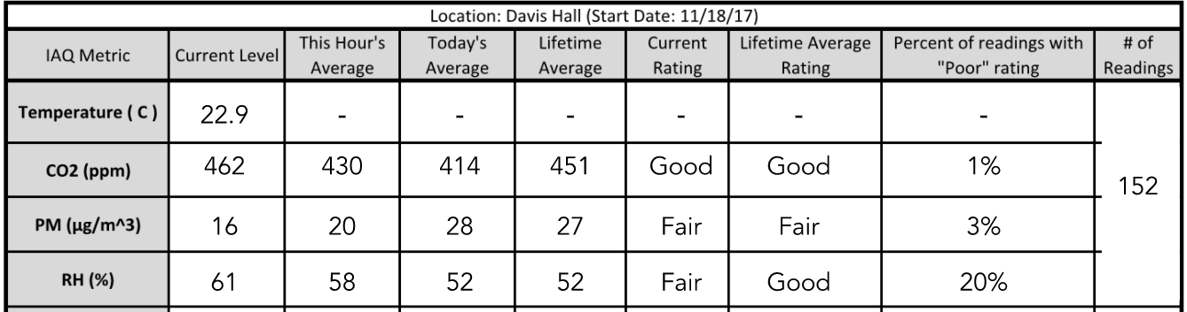




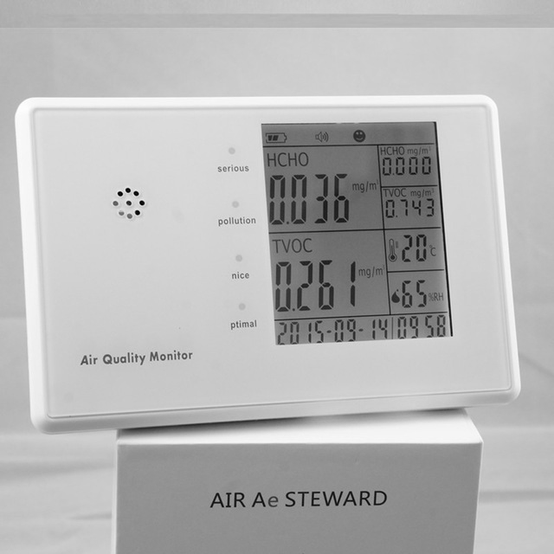
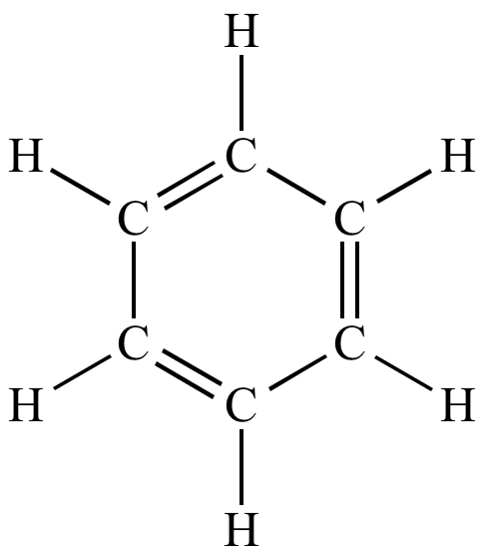







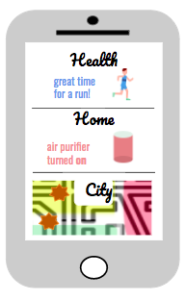
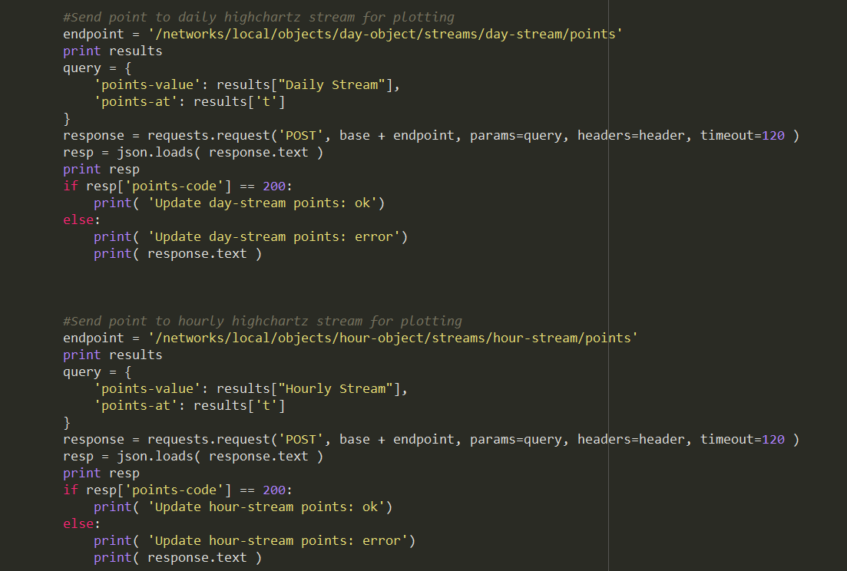



















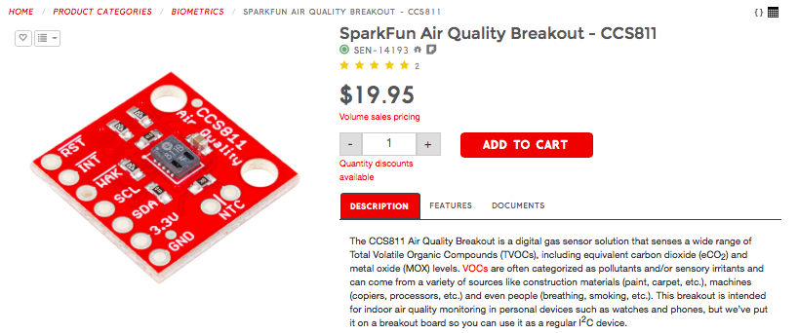
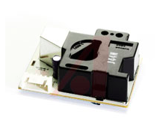
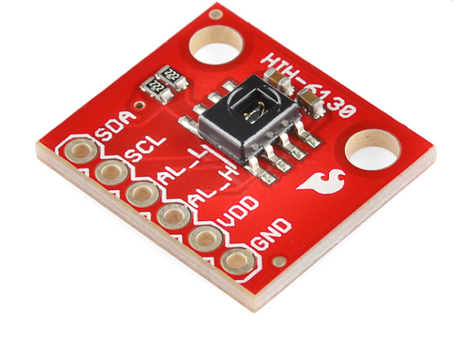
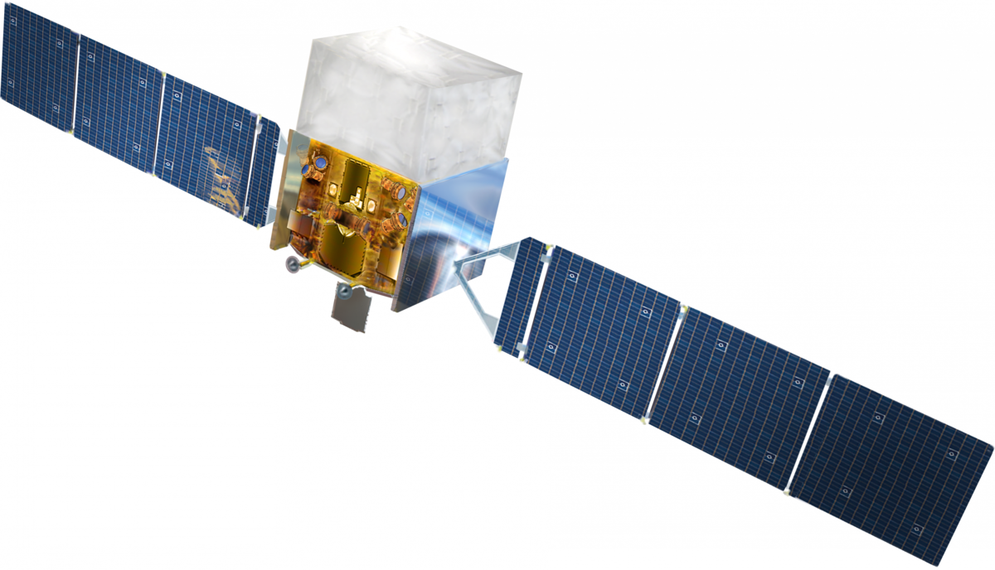
SMART AIR
BEARS
low-cost cyber-physical air quality sensors to create empowered personal pollution monitoring for all
Garima Raheja, John Stuart, Matt Choi, Brian Tam
Civil Engineering 186 - Fall 2017 at the University of California, Berkeley
BACKGROUND AND MOTIVATION
OUR PRODUCT
RECOMMENDATION PLATFORM
1 85%
1 in 8
billion people suffer from respiratory illnesses aggravated by contaminated air
machine learning algorithms and scientific standards are used to generate personal health recommendations
Health
of the world’s population lives in areas
that do not meet WHO Air Quality Guidelines
great time
for a run!
sensors connect with smart home devices (IoT) to maintain
indoor air quality
global deaths are attributed to poor air quality
Home
crowdsourcing provides outdoor air quality based recommendations for safe breathing areas
air purifier
turned on
City
CURRENT SOLUTIONS
REAL - TIME MONITORING PLATFORMS
$$
expensive
impersonal
Low-cost ambient air quality sensor + mobile app
POLLUTANTS MEASURED
fine particulate matter (PM)
volatile organic compounds (VOC)
carbon dioxide (CO₂)
temperature, relative humidity
TOOLS
granular, location-based air quality mapping
personal air improvement recommendations
COST $59
?
?
PM
windows
mask
unreliable
safe
purifier
?
?
move
CO₂
VOC
unhelpful
outdoors
go for a run
TECHNICAL INTEGRATION
POLITICAL INTEGRATION
Top left: Personal air quality monitors price in the hundreds, making this option too expensive for most communities.
Top right: Regional air quality monitoring provides helpful data at a large scale, but does not capture the heterogeneity of personal-scale air quality, making it too impersonal to extract meaningful human-scale data.
Bottom left: Even with high-quality data, individuals are unsure how to use this data to make the best possible personal health and infrastructure decisions for themselves.
Bottom right: Online tools for navigating health decisions are unreliable and often contradictory.
1 0 1 1 0
0 1 1 1 1 1
user history
prescription information
personal health data
CO₂
regional average
THE VISION
lifestyle suggestions
building facilities
VOC
PM
building commands
CO₂ >
PM 2.5 = Standards
VOC <
relocation suggestions
doctor recommendation
BAAQMD
EPA
City Council
State Capitol
$
SENSOR DEVICES
CONCLUSIONS & FUTURE WORK
VOC
CO₂
PM
%
High-quality, fine-scale air pollution data is vital to creating healthy communities. We create low-cost sensors in the hopes of enabling a ubiquitous sensor network that serves two purposes: first, to empower communities and individuals to assess their own environmental health, and second, to send notes to public health officials in the hopes of guiding public policy towards helping the communities most in need of political and technical solutions.
Further, our recommendation platform uses cloud computing and scientific data to produce personalized health recommendations to individuals to empower them to make personal decisions that create safe and healthy living situations. Recommendations include personal activity suggestions, home device (IoT) actuation, and regional mapping of air quality for relocation assessment.
We hope to see these low-cost sensors around the Bay Area community and worldwide, monitoring indoor and outdoor air quality. As we develop Smart Air Bears further, we hope to increase the personalization and effective recommendation strategies in our recommendation platform to incorporate personal health histories and medical suggestions.
1 0 1 1 0
0 1 1 1 1 1
Σ % + #
Top: We seek to create low-cost air quality sensors to make them ubiquitous, indoors and outdoors, creating a wide-ranging, fine-scale sensor network that enables fine-scale personal quality mapping.
Bottom: Using the cloud, personal and mobile devices transform into personal health decision making tools that factor medical advice and regional data into recommendations for each user.
SparkFun Air Quality Sensor
Breakout Model # CCS811
Amphenol Advanced Sensors SM-PWM-01C
SparkFun Humidity and Temperature Sensor HIH6130
In-Built Geoloc
& Satellite Data

